Slide 1
Angular Forms and Validation
Deborah Kurata
@deborahkurata http://blogs.msmvps.com/deborahk deborahk@insteptech.com
Notes:
It’s not enough for a data entry form just to collect data. It should facilitate entry of relevant, accurate, and valid data. And it should help prevent entry of incorrect, invalid, and erroneous data. This session covers how to build Angular forms and implement data entry validation. The demonstrations include simple validation, displaying validation messages, building custom validators, and working with asynchronous validators.

Slide 2
Deborah Kurata
Independent Consultant | Developer | Mentor
Web (Angular), .NET
Pluralsight Author
AngularJS Line of Business Applications
Angular Front to Back with Web API
Object-Oriented Programming Fundamentals in C#
Microsoft MVP

Slide 3
Session Materials & Sample Code
https://github.com/DeborahK/ab2015

Slide 4
Rate Yourself on Forms and Validation
New to Angular - no proficiency
Just starting out - limited proficiency
Doing it but not fully understanding it - working proficiency
Been there, done that, can help others - full proficiency

Slide 5

Overview
Building a data entry form
Basic validation
Validation messages
Data Binding Options
Custom validators
Asynchronous validators
Peek at Angular 2 Forms

Slide 6
Demo: Angular in Action
Notes:
Product Management
Point out the validation of the form.
2) Movie Hunter
Point out the validation.
This is the code we will look at in this session

Slide 7
Creating a Form
<form name="movieForm">
<fieldset>
<legend>Edit Movie Information</legend>
</fieldset>
</form>
It's just HTML
Notes:
When the request is complete:
The callback function is executed
The response object is passed in

Slide 8
Adding Controls to a Form
<div>
<label for="inputMovieTitle">
Movie Title</label>
<input id ="inputMovieTitle“
type="text"
placeholder="Movie Title" />
</div>
<div>
<label for="inputDescription">
Description</label>
<textarea id="inputDescription“
placeholder="Description"
rows="3" />
</div>
Notes:
More HTML
Id is used for matching with the label.
How do you get data onto the form?

Slide 9
Data Binding
One-Way Binding
View is the projection of the model
When the model changes, the view reflects the change
Two-Way Binding
View and model data are synchronized
Changes to the model are reflected in the view
Changes in the view are reflected in the model

Slide 10
One-Way Binding
movieHunter
movieListView
MovieListCtrl
<div>
Binding
{{vm.movie.title}}
Model
</div>

Slide 11
Two-Way Binding
movieHunter
movieEditView
MovieEditCtrl
<form name="movieForm">
<input
name=inputMovieTitle
Directive
ng-model = "vm.movie.title"
Model
/>
</form>

Slide 12
Two-Way Binding
<div>
<label for="inputMovieTitle">
Movie Title</label>
<input id ="inputMovieTitle“
type="text"
placeholder="Movie Title" />
</div>
<div>
<label for="inputDescription">
Description</label>
<textarea id="inputDescription“
placeholder="Description"
rows="3" />
</div>
Notes:
More HTML
Id is used for matching with the label.
How do you get data onto the form?

Slide 13
Two-Way Binding
<div>
<label for="inputMovieTitle">
Movie Title</label>
<input id ="inputMovieTitle“
type="text"
placeholder="Movie Title"
ng-model="vm.movie.title" />
</div>
<div>
<label for="inputDescription">
Description</label>
<textarea id="inputDescription“
placeholder="Description"
rows="3"
ng-model="vm.movie.description" />
</div>
Notes:
More HTML
Name is used by Angular
Id is used for matching with the label.
How do you get data onto the form?

Slide 14
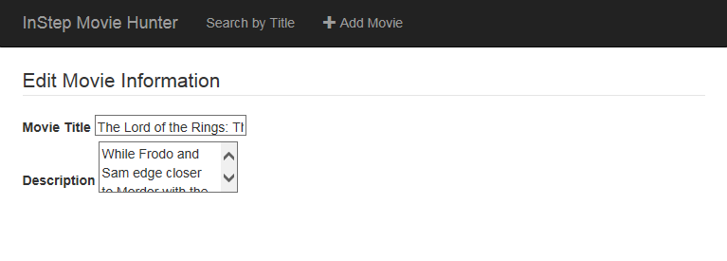
The Result
Notes:
That does not look very nice!
Bootstrap to the rescue!

Slide 15
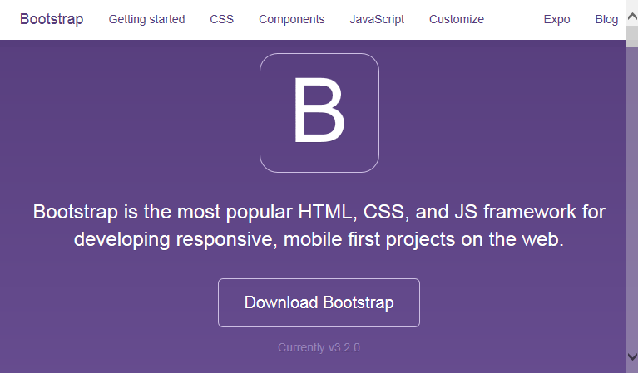
Bootstrap
Framework for prettifying Web pages
Developed by Twitter
http://getbootstrap.com/
Large third party community

Slide 16
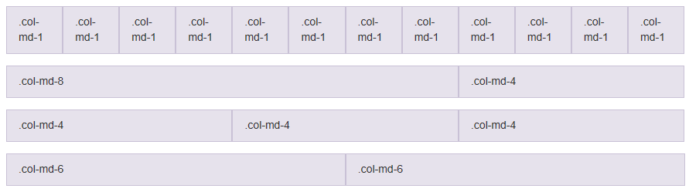
Bootstrap Grid System

Slide 17
Bootstrap Styles
<div class="form-group">
<label class="col-md-2 control-label" for="inputMovieTitle">
Movie Title</label>
<div class="col-md-6">
<input class="form-control"
id ="inputMovieTitle"
type="text"
placeholder="Movie Title"
ng-model="vm.movie.title" />
</div>
</div>
Notes:
Bootstrap classes

Slide 18
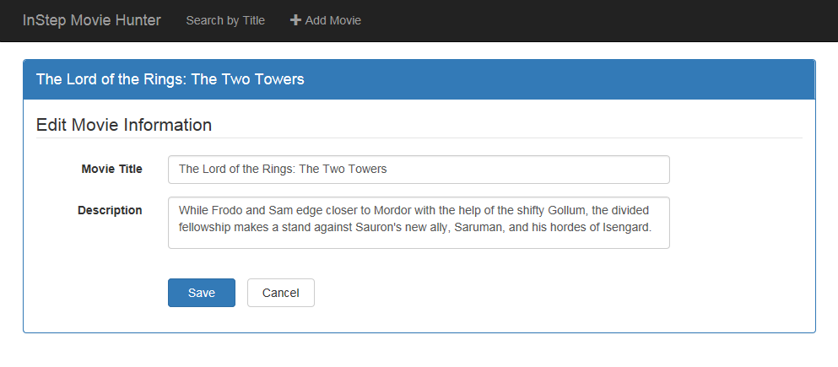
The Result
Notes:
MUCH BETTER!

Slide 19
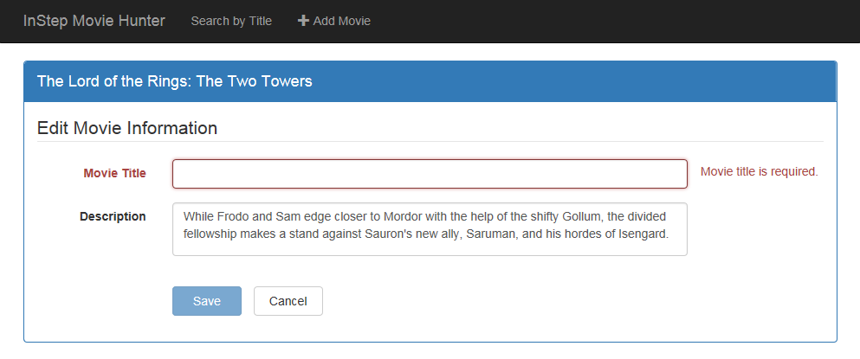
Validation
Notes:
Notice the color change and the associated message text.
Also notice that the Save button is now disabled.

Slide 20
Prepare the form
Ensure the form has a name
Set the novalidate attribute
<form class="form-horizontal"
name="movieForm">
<form class="form-horizontal"
name="movieForm"
novalidate>

Slide 21
Angular Validation Techniques
Type Attribute
type="email"
Required Attribute
required
HTML Validation Attributes
min = "1"
Angular Validation Attributes
ng-minlength = "3"
Custom Angular Directive
my-directive=""
Notes:
Type Attribute (standard HTML 5 validators): email, tel, url, number, etc
ng-minlength, ng-maxlength, ng-pattern

Slide 22
Validation Attributes
<div class="col-md-8">
<input class="form-control"
id="inputMovieTitle"
name="inputMovieTitle"
type="text"
placeholder="Title (required)"
ng-model="vm.movie.title"
required
ng-minlength="3"
ng-maxlength="50" />
</div>
Notes:
First, ensure the control has a name. The validation uses the name.
Second, set the desired validation attributes

Slide 23
Marking Invalid Elements
ngClass Directive
Angular Validation States
Bootstrap Style
<div class="form-group"
ng-class="{'has-error': movieForm.inputMovieTitle.$invalid && movieForm.inputMovieTitle.$dirty}">
</div>
Notes:
ng-class defines the style class
'has-error' is the bootstrap style
movieForm -> name of the form
inputMovieTitle -> name of the control
$invalid -> Angular validation state
$dirty -> Prevents display of the message until the user has edited the field.

Slide 24
Angular Validation States
$pristine
Value has not been changed
$dirty
Value has been changed
$valid
Value is valid
$invalid
Value is invalid
$error
All validations and whether they are valid or invalid

Slide 25
Angular Validation States: New in 1.3
Control never "touched" (blur)
$untouched
Control was "touched" (on blur)
$touched
Notes:
Blur => lost focus
Good for validation when the user enters a required field but does not change it.

Slide 26
Validation States
Notes:
But changing the style is not enough. We also want to display a message.

Slide 27
ngMessages: New in 1.3
Requires
angular-messages
ngMessages
ng-Messages
Shows or hides messages
ng-Message
Defines specific cases
Similar to a switch or case statement
<span class="help-block">
<span ng-messages="movieForm.inputMovieTitle.$error">
<span ng-message="required">Movie title is required</span>
<span ng-message="minlength">Must be at least 3 characters</span>
<span ng-message="maxlength">Cannot exceed 50 characters</span>
</span>
</span>

Slide 28
Demo: Forms & Validation
Notes:
Show the movieEditView.html file.
Run
Demo the Edit page + Validation
Demo the Add page + Validation
Notice that the Star Rating message appears immediately, before the user has a chance to type.
Demonstrate the difference between ng-if="….required" vs "….touched"

Slide 29
Creating a Messages File
validationMessages.html
<span ng-message="required">Value is required</span>
<span ng-message="minlength">Value is too small</span>
<span ng-message="maxlength">Value is too long</span>
movieEditView.html
<span ng-messages="movieForm.inputMovieTitle.$error"
ng-messages-include="app/validationMessages.html">
</span>

Slide 30
Demo: Messages File

Slide 31
Data Binding Options
By default, validation occurs as the user types
Use ng-model-options to change when the binding occurs
{updateOn: 'blur'}
{debounce: 1500}
{updateOn: 'submit'}
Notes:
{updateOn:'blur'} prevents update of the model until the user leaves the field.
{debounce: 1500} prevents update of the model until the specified amount of time.
{updateOn:'submit'} prevent update of the model until the form is submitted.
Can then undo the entire form.
Not very userfriendly
Let's try out some data binding options.

Slide 32
Demo: Binding Options
Notes:
Set the ng-model-options
{updateOn: 'blur'} -> good for cases such as an email that is not valid until the majority of it is entered.
{debounce: 1500}
{debounce: {'default':1500, 'blur':0}}

Slide 33
Rolling Back Changes to a Field
If using ng-model-options, the model is not changed as the user types
Changes to a field can be rolled back.
Use ng-model-options to change when the binding occurs
ng-keyup="vm.cancelEntry(movieForm. inputMovieTitle, $event)"
vm.cancelEntry = function (control, event) { if (event.keyCode == 27) { control.$rollbackViewValue(); } };
Notes:
{updateOn:'blur'} prevents update of the model until the user leaves the field.
{debounce: 1500} prevents update of the model until the specified amount of time.
Let's try these.

Slide 34
Demo: Rolling Back Changes
Notes:
Set the ng-keyup
ng-keyup="vm.cancelEntry(movieForm.inputMovieTitle, $event)"
Uncomment out the cancelEntry method.
control.$rollbackViewValue();

Slide 35
Custom Validator
directorMinRatingValidator.js
function directorMinRatingValidator() {
. . .
}
Developed as a directive
ngModel.$validators
Collection of validators
Returns true/false
Used as an attribute
movieEditView.html
<input id="inputStarRating"
type="number"
ng-model="vm.movie.starRating"
required
director-min-rating-validator="vm.movie.director" min="1"
max="5"/>
Notes:
Custom validators are great for cross field checking.
In this example, we want to perform validation on the star rating based on the selected director.

Slide 36
Demo: Custom Validators
Notes:
The code for this is a little more complex. Let's take a look.
common.services.js
directorMinRatingValidator.js
movieEditView.html
Be sure to show change to EITHER star rating OR director

Slide 37
Asynchronous Validator
duplicateTitleValidator.js
function duplicateTitleValidator () {
. . .
}
Developed as a directive
ngModel.$asyncValidators
Collection of validators
Returns promise
Used as an attribute
movieEditView.html
<input id="inputMovieTitle"
type="text"
ng-model="vm.movie.title"
required
duplicate-title-validator="vm.movie.movieId" ng-minlength="3"
ng-maxlength="50"/>
Notes:
These are great for:
Duplicate value checking
Validation against server-side business rules

Slide 38
Demo: Async Validators
Notes:
The code for this is a little more complex. Let's take a look.
common.services.js
duplicateTitleValidator.js
movieEditView.html
NOTE: This is calling the server for every character the user is typing!!
This is a good place for some of those model options

Slide 39
Angular 2 Forms
https://angular.io/

Slide 40
Why Change?
Support complex logic
- One control can depend on the logic of another
- User's fill out forms in an ad hoc manner
- Error states are triggered often
Better handle changes
- Waiting for responses from the server
- Changes triggering update on dependent controls
Improve testing
- Currently difficult to test forms with a unit test
Handled with Controls and Validators
Simplified with Observables
Isolated with DOM independent controls

Slide 41
Angular 2 Forms
Will be an external module
Like ngMessage and ngResource
Three techniques
Imperative Driven
Data Driven
Template Driven
Built w/Code
Automatic
Similar to 1.x
Notes:
Three ways to create a form:
Imperative Design: New technique
Data Driven: Automatic generation of the form from the data and some attributes
Template Driven: Similar to 1.x

Slide 42
Angular 2: Component Definition
Annotations
@Component({
selector: 'todo-app'
})
@View({
url: 'todos.html'
})
Class TodoApp {
todos: [string];
constructor() {
this.todos = ['Item1', 'Item2'];
}
addTodo(title: string) {
this.todos.push(title);
}
}
Controller
Form Element
<todo-app></todo-app>
Notes:
Angular 2 breaks the UI down into reusable pieces called components.
Annotations customize the component
@component selector defines the element (similar to 1.x directive)
@view defines the path to the HTML template for the view
Backing class is the code behind for the view (similar to 1.x controller)

Slide 43
Angular 2: View
Local Variable
#localvar
<input
type="text"
#toDoTextbox />
<button (click)="addTodo(toDoTextbox.value)">Add</button>
<div [innertext]="toDoTextbox.value"></div>
Event Handler
(event)
Property Bindings
[innerText]
Notes:
New Template Syntax
1) Defines a local variable for referencing the input element.
2) Registering a click event and calling the method in the component class.
3) Binding the innerText of the div to the textbox's value.
Binds to the DOM property.

Slide 44
Imperative Driven: Controls & Validators
var builder = new FormBuilder();
// create a control group
var group = builder.group({
firstName: ["Chris", Validators.required],
lastName: ["Smith", Validators.required],
address: [""]
});
// check states
Var isValid = group.valid;
Var isChanged = group.dirty;
Var numErrors = group.errors.length;
Notes:
Control => Smallest piece of Angular forms, represents a single form input
In the imperative driven approach, create the controls with code.
Array represents a control.
Can also nest groups.
Validator => Functions that encapsulate custom form logic

Slide 45
Example: Component
import {bootstrap, Component, View} from 'angular2/angular2';
import {FormBuilder, Validators, FormDirectives, ControlGroup} from 'angular2/forms';
@Component({ selector: 'form-app', injectables: [FormBuilder]})
@View({ url: 'form-app.html', directives: [FormDirectives]})
class FormApp {
infoForm: ControlGroup;
constructor(builder: FormBuilder) {
this.infoForm = builder.group({
firstName: ["", Validators.required],
lastName: ["", Validators.required],
address: [""]
});
}
}
Notes:
Import the components (ES6 module syntax)
Component annotation
View annotation
Component controller
Dependency injection done through the constructor function

Slide 46
Example: View
Property Binding
<div [control-group]="infoForm">
<input [control]="infoForm.controls.firstName">
<input [control]="infoForm.controls.lastName">
<input [control]="infoForm.controls.address">
<!-- control decorator short cut -->
<input control="firstName">
<input control="lastName">
<input control="address">
{{ infoForm.controls.firstName.value }}
</div>
Control Decorator
Notes:
[control-group] property binding declares the form for the view.
[control] property binding binds the control to the input
For a shorter syntax, use the "control decorator" for binding the control to the input
SO THAT'S A VERY QUICK PEEK AT Angular 2 FORMS

Slide 47
Take Away
Use client-side validation where possible
Display friendly and helpful messages
Use directives to create custom & async validation
Keep an eye on Angular 2 progress

Slide 48
Thank You!
@deborahkurata
deborahk@insteptech.com
http://blogs.msmvps.com/deborahk
https://github.com/DeborahK/ab2015

